Slide 1
Kim Barclay
Anxiety and Resilience

Slide 2
Aims of today
By the end of this session you will:
Have a general understanding of anxiety
Have an understanding of what resilience is and its relevance to anxiety
How to check in on your resilience and suggestions for how to build resilience

Slide 3
Overview of our session
What is anxiety
How we might experience it
The difference between typical and overwhelming or disordered anxiety
What is resilience – the element of resilience
How do we know if we are resilient
How can we become or build on our resilience

Slide 4
Group agreement
Confidentiality
It important that we feel challenged to help us learn but if we become to uncomfortable to option to opt out is always available.
Ask all the questions the only silly question is the one you don’t ask.
Treat others as you’d like to be treated
Be present, join in, have fun.

Slide 5
What is anxiety?
The bodies fire alarm – an indicator of possible threat
A call to action
Triggers the flight fight freeze response
Normal and expected
Typical anxiety
Trigger
Perception of threat
Anxiety response
Successful coping strategy
Anxiety resolved
Linear
Everyone will experience this to some degree!

Slide 6
How we might experience anxiety
This can very person to persons but may include some of the following:
Physical signs – butterflies in stomach, clammy hands, sweating, needing to go to the toilet a lot, tension in the jaw, shoulders back (anywhere really). More prolonged experiences might include worsening of stress related illness such as eczema, migraine issues with sleep.
Thoughts and feelings- Worry, not being sure you can manage, anger and frustration, embarrassment, berating yourself. Rumination and cognitive distortions
Behaviours- Tapping or fidgeting, going to the toilet more, safety seeking behaviours including avoidance, blaming self and others, arguing more often, seeming uncooperative, issues making decisions.
This is not an exhaustive list!

Slide 7
Examples of when linear experience becomes cyclical
Issues with threat perception/ cognitive distortions
Coping strategies that don’t actually help
Drug and alcohol use
Excessive planning
Avoidance
All or nothing thinking – its great or terrible nothing in between
Catastrophizing – assuming the worst will happen (and also ignoring when the best happens)
Mind reading/ fortune telling - might look like ‘ I know what he’s going to say’ or ‘ I knew this would go wrong’
Emotional reasoning -’this is horrible’ rather than I’m finding this challenging
Personalizing and blaming – taking responsabitly for instances you had no control over.
Labelling – rather than saying ‘I made a mistake’ saying ‘I am a failure’

Slide 8
Could indicate that an aspect of the linear experience of
anxiety has become cyclical or problematic for example;
We might be worrying about something outside of our
control or using a coping strategy that doesn’t actually help
When anxiety becomes overwhelming or disordered
or
A diagnosis may be useful
This will relate to how impactful (severe) , chronic (duration) or to what degree the experience impedes day to day function.
Common diagnosis include:
GAD – general anxiety disorder
Panic disorder- meta panic
PTSD – Post traumatic stress disorder
OCD – obsessive compulsive disorder.

Slide 9
Break

Slide 10
Resilience Is……?
Our ability to cope with adversity and life's challenges

Slide 11
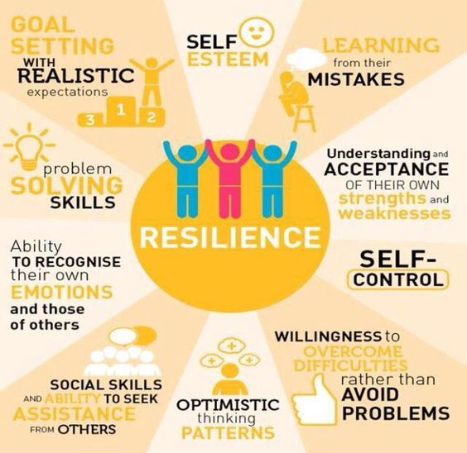
Elements of resilience

Slide 12
How can we know we’re resilient?
 | Strongly disagree | Disagree | Neutral | Agree | Strongly agree
I tend to bounce back quickly after hard times
I have a hard time making it through stressful times
It doesn’t take me long top recover from a stressful event
It’s hard for me to snap back when something bad happens
I usually come through difficult times with little trouble
I tend to take a long time to get over setbacks in life
1 2 3 4 5
5 4 3 2 1
1 2 3 4 5
5 4 3 2 1
1 2 3 4 5
5 4 3 2 1
Add the scores allocated to each of your responses and divide your total by 6.
BRS score | Interpretation
1.00-2.99 | Low resilience
3.00-4.30 | Normal resilience
4.31-5.00 | High resilience

Slide 13
How to build resilience

Slide 14
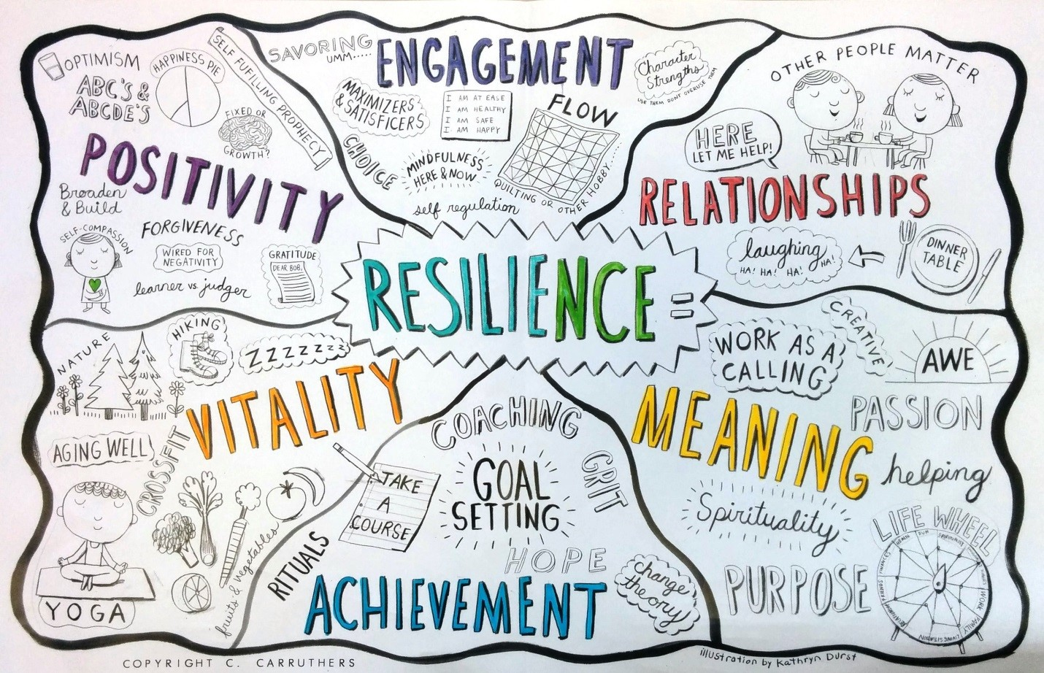

Slide 15
Useful sources of information
NHS guide to sleep hygiene with teenager
https://www.nhs.uk/live-well/sleep-and-tiredness/sleep-tips-for-teenagers/
NHS mood zone
https://www.nhs.uk/conditions/stress-anxiety-depression/
NHS app library
https://www.nhs.uk/apps-library/
Tips and suggestions for mindfulness activities with young people
https://www.doyouyoga.com/10-cool-meditations-for-pre-teens-and-teens-67578/ https://positivepsychology.com/mindfulness-for-children-kids-activities/

Slide 16
References
https://www.apa.org/helpcenter/resilience
https://youngminds.org.uk/find-help/for-parents/parents-guide-to-support-a-z/parents-guide-to-support-anxiety/
https://www.rcpsych.ac.uk/mental-health/parents-and-young-people/information-for-parents-and-carers/worries-and-anxieties---helping-children-to-cope-for-parents-and-carers
https://www.anxietyuk.org.uk/get-help/anxiety-information/young-people-and-anxiety/
https://www.heysigmund.com/anxiety-in-kids-and-teens-avoidance-brave-behaviour
https://positivepsychology.com/3-resilience-scales/
https://www.psytoolkit.org/survey-library/resilience-brs.html
https://www.parentingni.org/about-us/
https://www.teacherspayteachers.com/Product/Behind-Anger-Free-Social-Emotional-Learning-Poster-School-Counseling-Decor-5296242
https://dontforgetthehalf.wordpress.com/2018/12/06/your-inner-circle-of-power/
https://www.blessingmanifesting.com/self-care-for-breakups/
http://www.elsa-support.co.uk/the-worry-tree/
https://www.allmentalhealth.org/

Slide 17
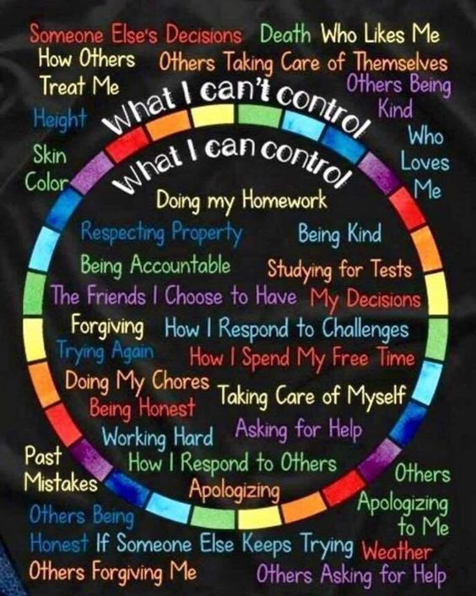
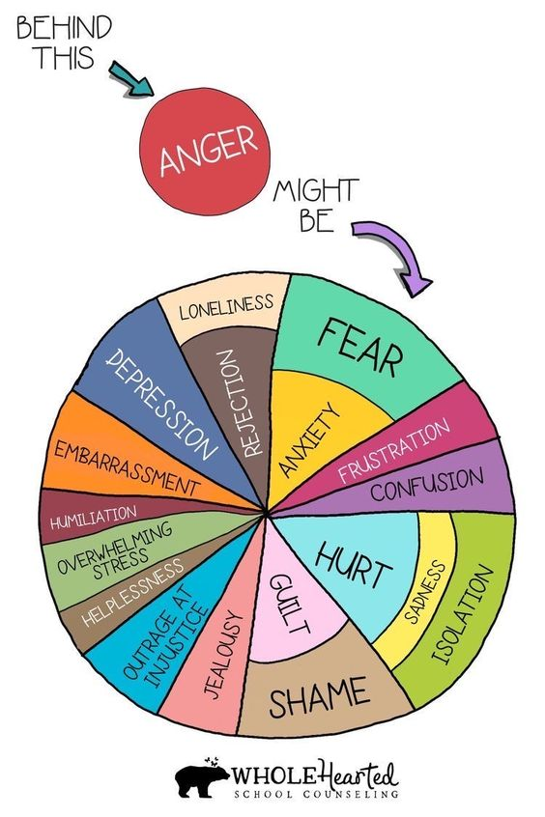

Slide 18
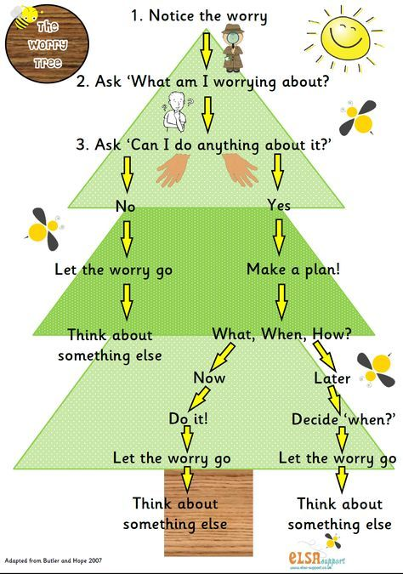
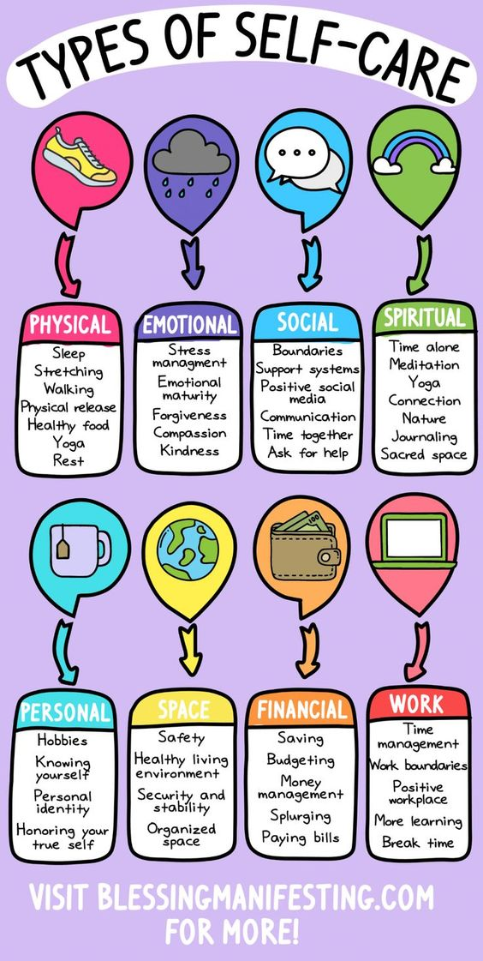

Slide 19
